Slide 1


ALTER 2030
Presented By
VICTOR
Notes:
Hi everyone we are from VICTOR Team. Today we will present our game name "ALTER 2030" but first let us introduce ourselves…

Slide 2

Members of VICTOR Team
Mr.Attapong Chaidhiravedj
Mr.Promchai Choosaeng
Mr.Waranthorn Chansawang

Slide 3


Discuss about the topic of our game
Design map
PROCESS
Insert materials
Writing the scripts
Test the game
Notes:
1.Discuss about the topic of our game
OK, so we discuss this topic of "ALTER 2030" cause it has possibility will occur in our world. For instance the world population is increasing every year, the resources will not be enough for human on the earth and the garbage will increasing.
2.Design map
For our topic, We have to design our map into future and arid.

Slide 4
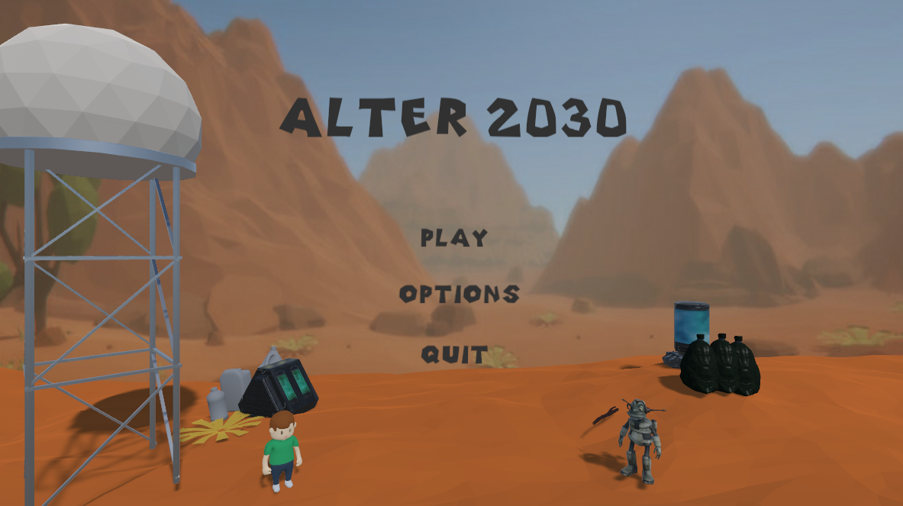

GAME
รูปเกม
Notes:
This is our game.

Slide 5

THEME
We want to encourage people who play this game to see the importance of the increasing of population and garbage on the world.
Notes:
This is the graph that show the population is increasing.

Slide 6


STORY
In 2030, the problem of scarcity of resources due to population growth and technological advances. At that same time, there was a problem of waste overflow the world. There were Aliens that can change the matter by their ability, so human asked Aliens for help by change the garbage to the trees which are important resources to be food for human and animals
Notes:
This is the graph that show the trend of garbage is increasing

Slide 7
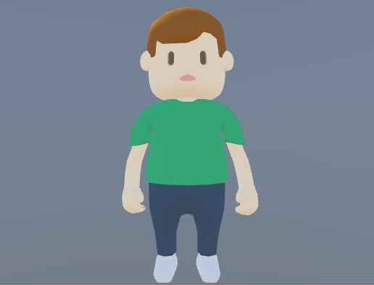
Boi
He can collects the plants and brings it to the Silo.
Notes:
Using W, A, S, D to move then collect the plants and bring it to Silo.

Slide 8
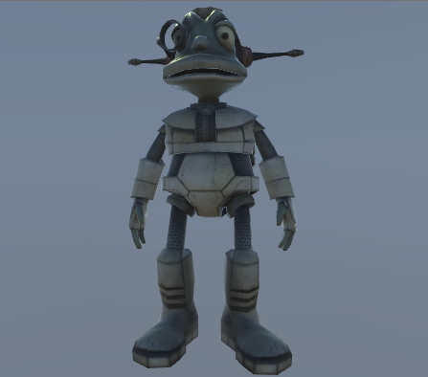
Alien
When he hits the garbage it will transform to plant.
Notes:
Using key arrow to move and hit the garbage for transform the garbage to plant. His arms are disable to catch plant he need help from Boi.

Slide 9
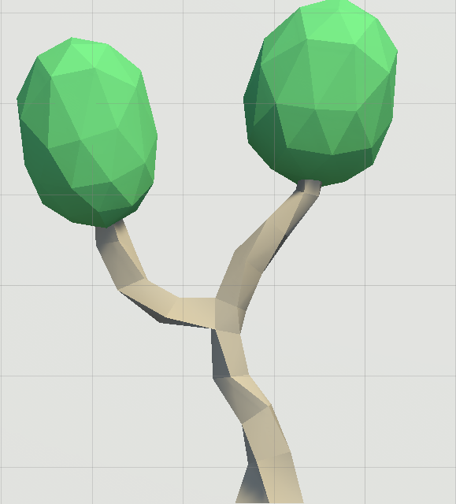
HOW TO PLAY
PLANT
They can help our world by healing our world
Notes:
You must collect the trees and bring it to Silo. Trees will be your scores

Slide 10
HOW TO PLAY
GARBAGE
Hit this to transform into plant.

Slide 11
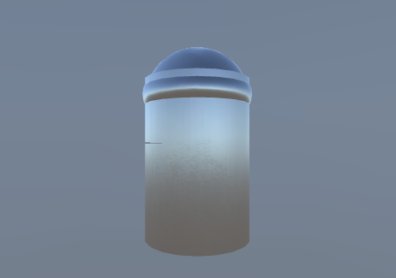
HOW TO PLAY
SILO
Bring the plants here to get scores

Slide 12

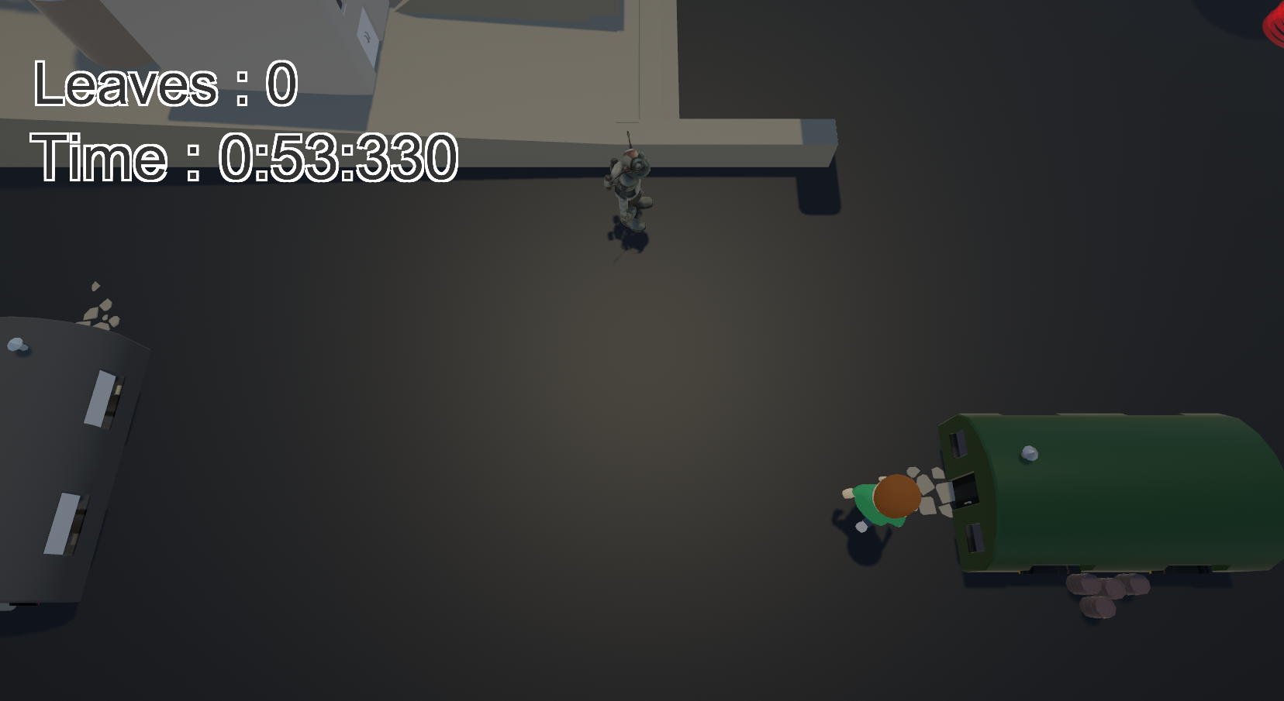
GAME RULES
Notes:
Player one controls Alien to hit the garbage to transforms garbage to plant. Player two controls Boi to collect plants and brings it to Silo for save the world and you will get scores. You must play 4 waves and it will be harder by time that will reduced and if you lose the game is over.

Slide 13

THANK YOU

